Slide 1



Industrial automation
Michiel Hamblok
Dennis Merken
Jason Vaesen
Bart Grispen
Arne Dubois
Abad Sethi

Slide 2
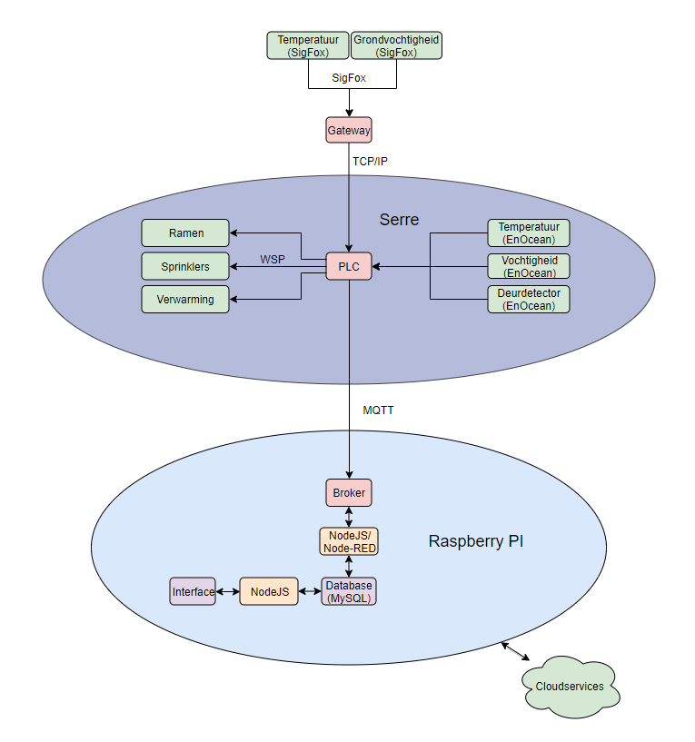
Inhoudsopgave
,,,
2

Slide 3
PLC
,,,
3
PLC - SigFox - Database/ NodeRed - Interface

Slide 4
Sigfox
,,,
4
PLC - SigFox - Database/ NodeRed - Interface

Slide 5
Database/ nodered
,,,,
5
PLC - SigFox - Database/ NodeRed - Interface

Slide 6
Database/ nodered
,,,
6
PLC - SigFox - Database/ NodeRed - Interface

Slide 7
Interface
,,,
7
PLC - SigFox - Database/ NodeRed - Interface

Slide 8
Einde

